Slide 1

Unit-3 AJAX & jQuery Concepts
Advanced Dot Net
#2101CS611
Prof. Naimish R. Vadodariya
Computer Science & Engineering Department
Naimish.vadodariya@darshan.ac.in
8866215253

Slide 2

Looping
Outline
AJAX Overview
How AJAX Works?
AJAX Methods
Understanding Ajax Call

Slide 3
Introduction to Ajax
Section - 1

Slide 4
AJAX Overview
Traditionally webpages required reloading to update their content.
For web-based email this meant that users had to manually reload their inbox to check and see if they had new mail.
This had huge drawbacks: it was slow and it required user input.
When the user reloaded their inbox, the server had to reconstruct the entire web page and resend all of the HTML, CSS, JavaScript, as well as the user's email.
This was hugely inefficient. Ideally, the server should only have to send the user's new messages, not the entire page.
By 2003, all the major browsers solved this issue by adopting the XMLHttpRequest (XHR) object, allowing browsers to communicate with the server without requiring a page reload.
AJAX is a method for exchanging data and information between a browser and a server without reloading the page.
With the widespread adoption of the XMLHttpRequest object it quickly became possible to build web applications like Google Maps, and Gmail that used XMLHttpRequest to get new map tiles, or new email without having to reload the entire page.

Slide 5
What is AJAX?
AJAX in ASP.net stands for Asynchronous JavaScript and XML.
This technique is used to develop rich web applications that are interactive, responsive, and dynamic in nature.
In ASP.NET Core, AJAX (Asynchronous JavaScript and XML) refers to a set of technologies and techniques that allow web applications to send and receive data from the server asynchronously, without requiring a full page refresh.
AJAX enables a smoother and more interactive user experience by updating specific parts of a web page dynamically, without reloading the entire page.
ASP.NET Core provides support for AJAX through various mechanisms, and you can use JavaScript frameworks like jQuery or modern approaches like Fetch API and async/await for making asynchronous requests.
Inshort, AJAX is a method for exchanging data and information between a browser and a server without reloading the page.

Slide 6
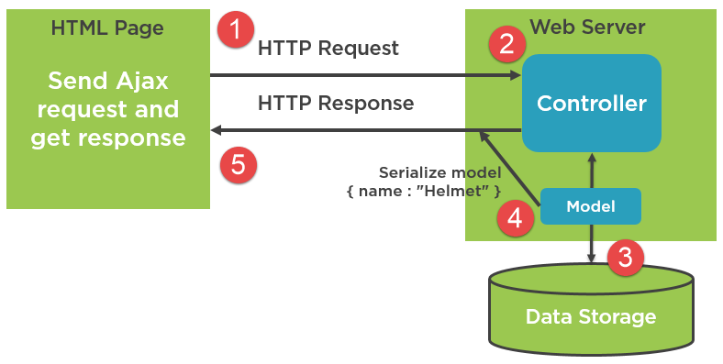
What is AJAX? Cont..
Ajax requests are triggered by JavaScript code; your code sends a request to a URL, and when it receives a response, a callback function can be triggered to handle the response.

Slide 7
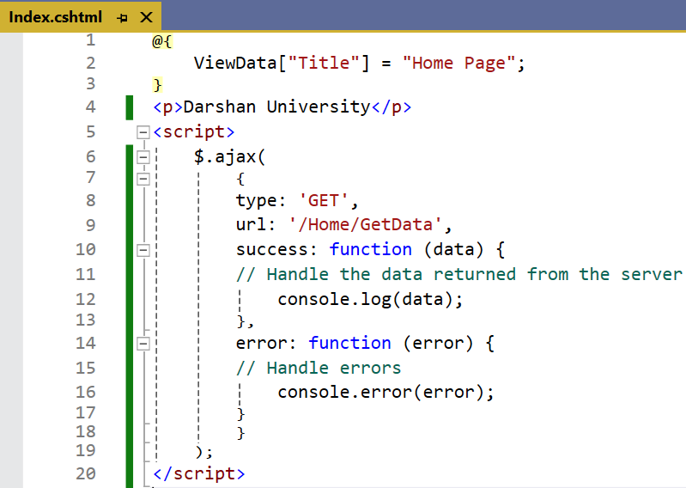
Example - AJAX

Slide 8
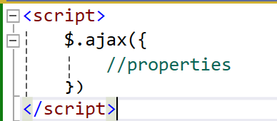
How to use Ajax?
Making request using Ajax is very simple. Syntax of Ajax in JavaScript is as follows.
Basic Properties of Ajax
url:
In this property you have to pass URL of your endpoint means when you want to post data.
type: (Ajax Call Methods)
Specify the type of request Post, Get, Put, Delete etc.
data:
Data that you want to pass to a given endpoint.

Slide 9
How to use Ajax? Cont..
Basic Properties of Ajax Cont..
success:
This property is a callback function called when request return with OK or 200 code means your request is successful.
This callback function also returns response data that pass from controller side.
error:
This property is also a callback function that return when any error occurs while calling endpoint like endpoint not exist or bad request etc.
This callback also have parameters which are request, status, and error.
async:
This is a Boolean property that is by default false.
If you pass true in this property it will call this request asynchronously means when sending this request other request also be called at the same time.
If this is false, other request are only be called after this request is complete.

Slide 10
Types of AJAX Call (Methods)
Methods | Description
GET() | Sends HTTP GET request to load the data from the server.
POST() | Sends HTTP POST request to submit or load the data to the server.
PUT() | Sends HTTP PUT request to update data on the server.
DELETE() | Sends HTTP DELETE request to delete data on the server.

Slide 11
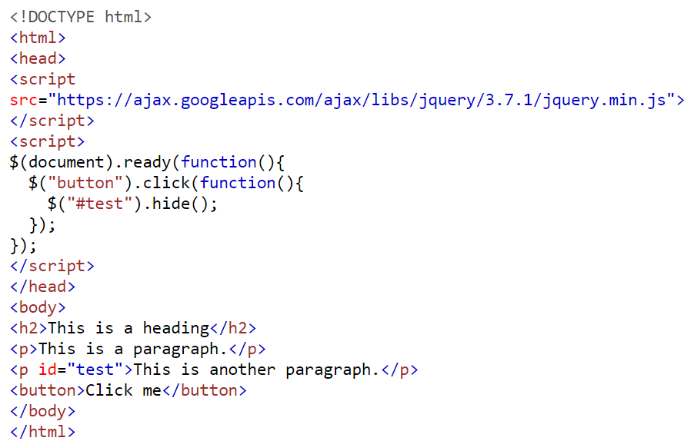
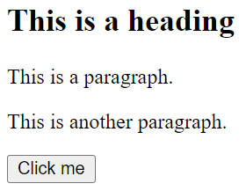
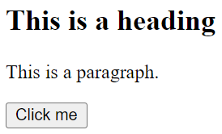
jQuery Example – Hide the element with id=“test”

Slide 12
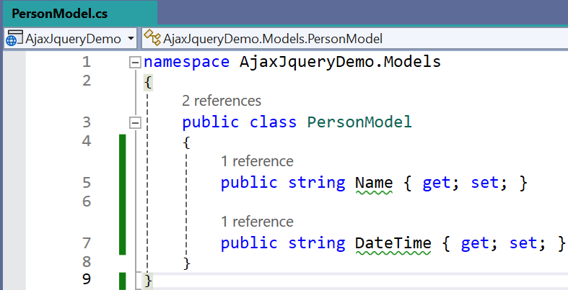
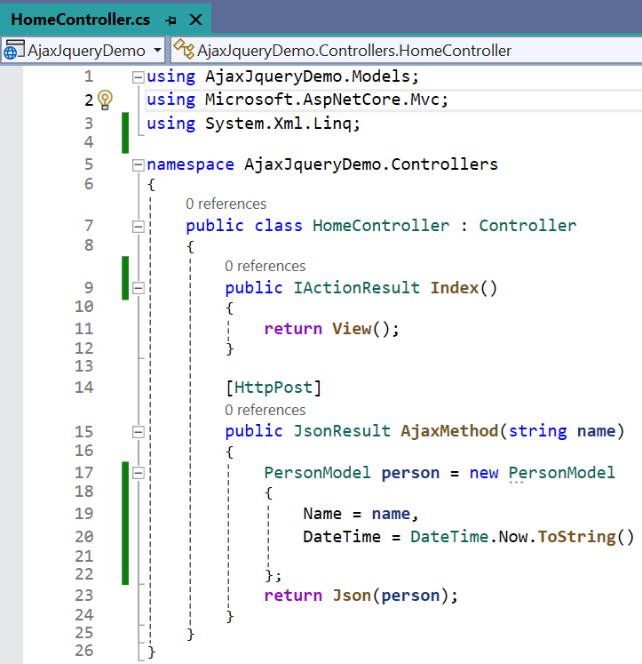
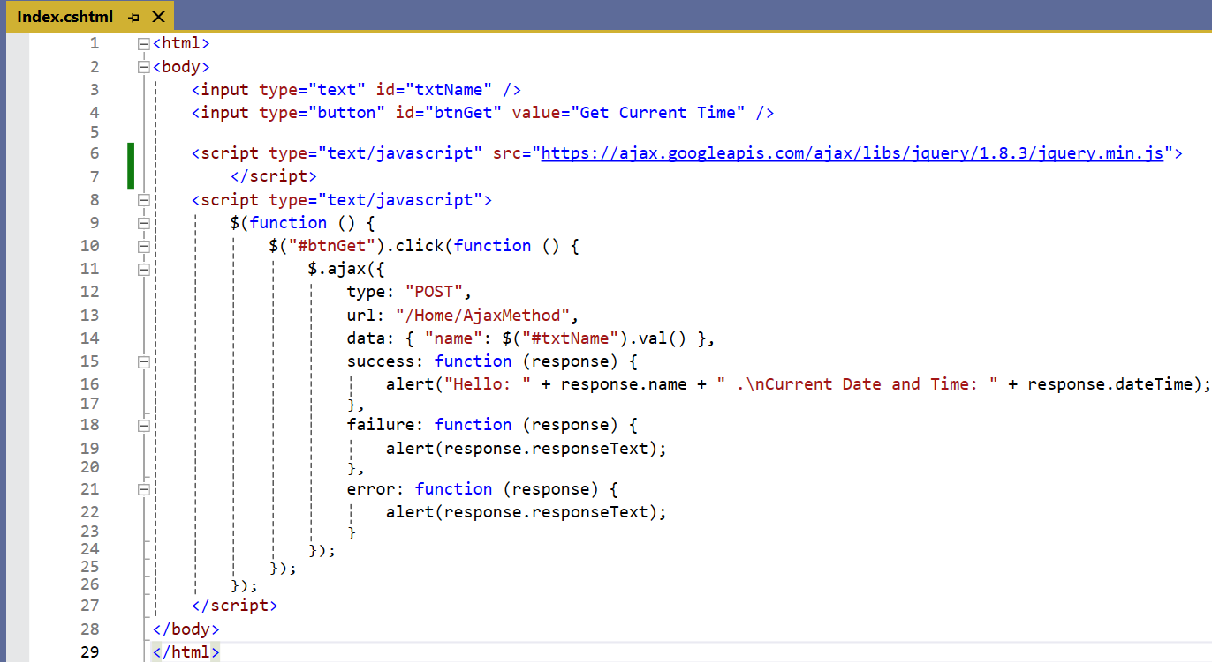
Basic Example - AJAX

Slide 13
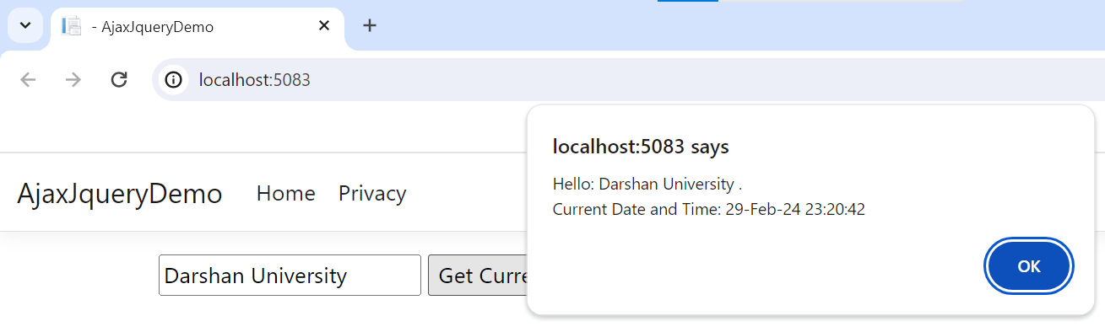
Basic Example – AJAX Output

Slide 14
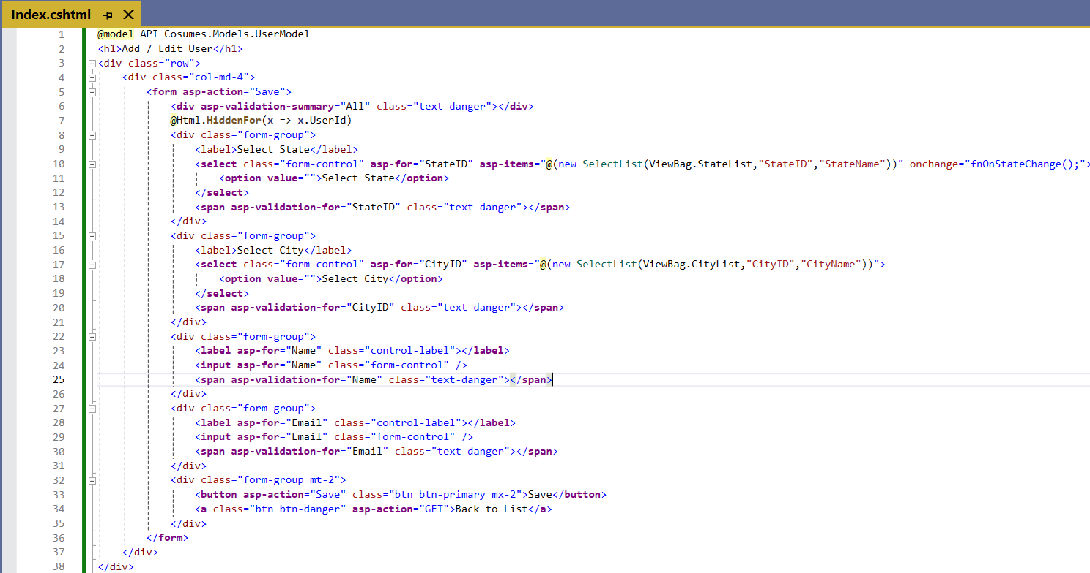
Index.cshtml [Design]

Slide 15
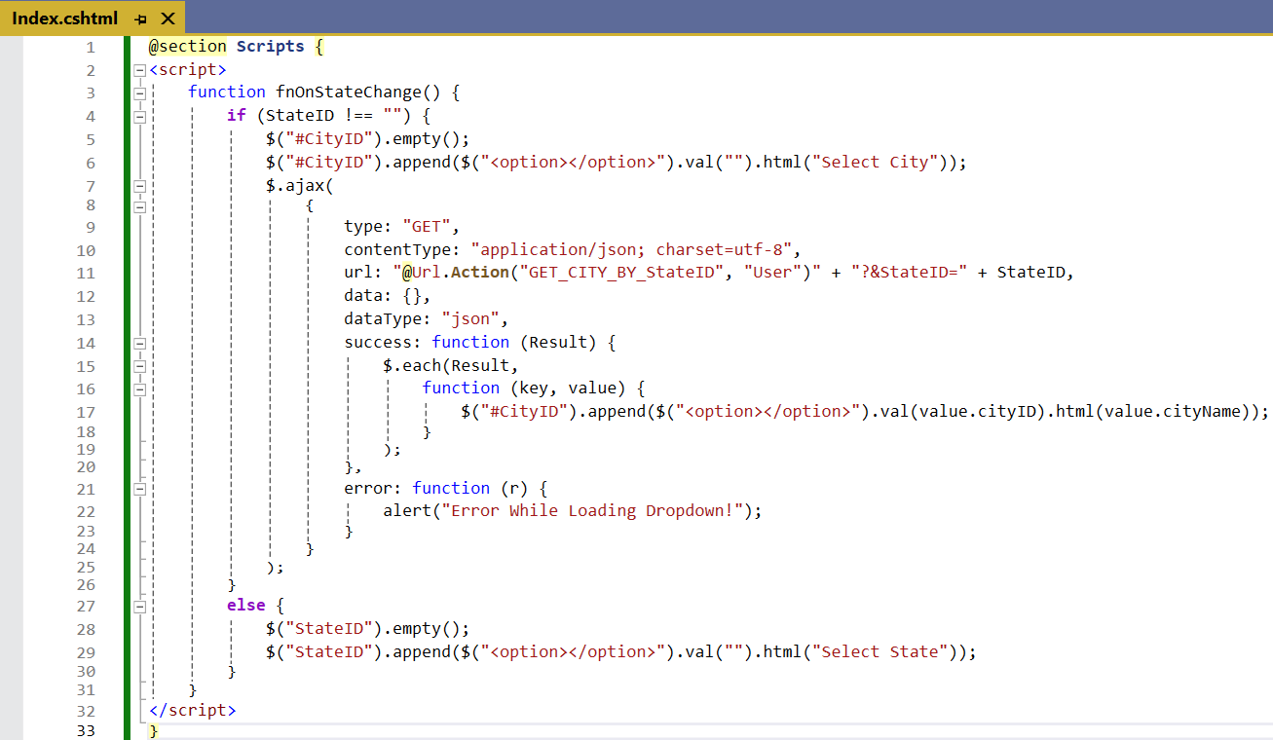
Example - (Get Cities By StateID) | Index.cshtml [Design]

Slide 16
Introduction to jQuery
Section - 1

Slide 17
jQuery Syntax
With jQuery you select (query) HTML elements and perform "actions" on them.
The jQuery syntax is tailor-made for selecting HTML elements and performing some action on the element(s).
Basic syntax is: $(selector).action()
A $ sign to define/access jQuery
A (selector) to "query (or find)" HTML elements
A jQuery action() to be performed on the element(s)
Examples:
$("p").hide() - hides all <p> elements.
$("#test").hide() - hides the element with id="test".
$(".du").hide() - hides all elements with class=“du".
$(this).hide() - hides the current element.

Slide 18
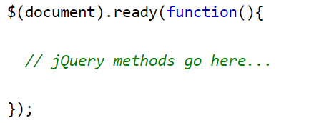
The Document Ready Event
You might have noticed that all jQuery methods in our examples, are inside a document ready event:
This is to prevent any jQuery code from running before the document is finished loading (is ready).
It is good practice to wait for the document to be fully loaded and ready before working with it.
This also allows you to have your JavaScript code before the body of your document, in the head section.

Slide 19
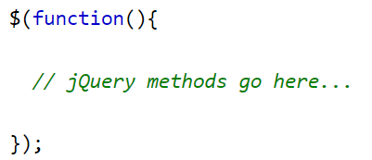
The Document Ready Event Cont..
Here are some examples of actions that can fail if methods are run before the document is fully loaded:
Trying to hide an element that is not created yet
Trying to get the size of an image that is not loaded yet
The jQuery team has also created an even shorter method for the document ready event:

Slide 20
What is jQuery?
jQuery is a typical client-side scripting toolkit that offers helpful functionality.
jQuery’s primary goal is to simplify the usage of JavaScript on websites.
jQuery reduces a lengthy method’s javascript code to a single line of code.
jQuery simplifies and reduces the complexity of Ajax and DOM calls.
A portion of jQuery’s functionality includes a high-level interface for performing AJAX queries.
jQuery recognizes the user’s actions and appropriately modifies the web page’s components.
jQuery conducts all work dynamically on the front end. Therefore, anytime an AJAX request is required, jQuery must be used.

Slide 21
Intro: jQuery
jQuery (@ http://jquery.com) is a JavaScript Library.
It is a small script (about 96kB minified) written in JavaScript called "jquery.js", which greatly simplifies JavaScript programming by providing cross-browser supports for DOM element selection and manipulation, event handling, Ajax request/response processing and animation.
jQuery is highly popular nowadays.
In May 2015, JQuery is used by 64.2% of all the websites.
Among the JavaScript libraries/frameworks, jQuery's market share is 95.2% In other words, most of the developers nowadays program in jQuery, rather than raw JavaScript.

Slide 22
jQuery Selectors
Syntax | Description
$("*") | Selects all elements
$(this) | Selects the current HTML element
$("p.intro") | Selects all <p> elements with class="intro"
$("p:first") | Selects the first <p> element
$("ul li:first") | Selects the first <li> element of the first <ul>
$("ul li:first-child") | Selects the first <li> element of every <ul>
$("[href]") | Selects all elements with an href attribute
$("a[target=‘_blank']") | Selects all <a> elements with a target attribute value equal to “_blank"
$("a[target!=‘_blank']") | Selects all <a> elements with a target attribute value NOT equal to “_blank"
$(":button") | Selects all <button> elements and <input> elements of type="button"
$("tr:even") | Selects all even <tr> elements
$("tr:odd") | Selects all odd <tr> elements

Slide 23
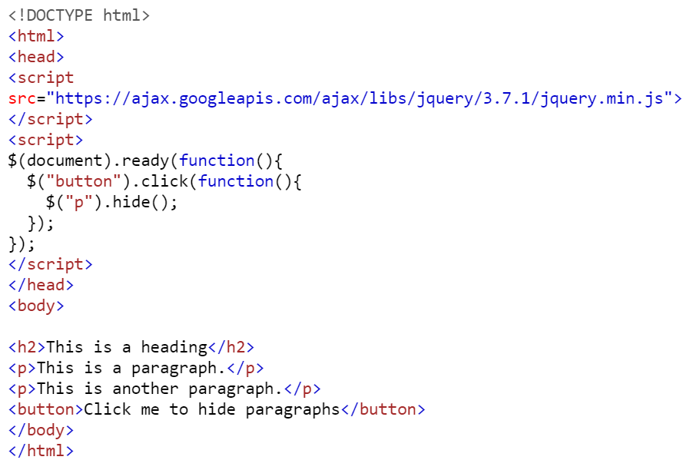
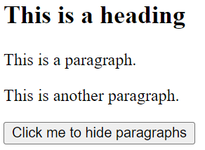
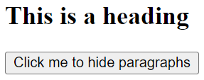
jQuery Example – 1 (Hide all <p> elements)

Slide 24
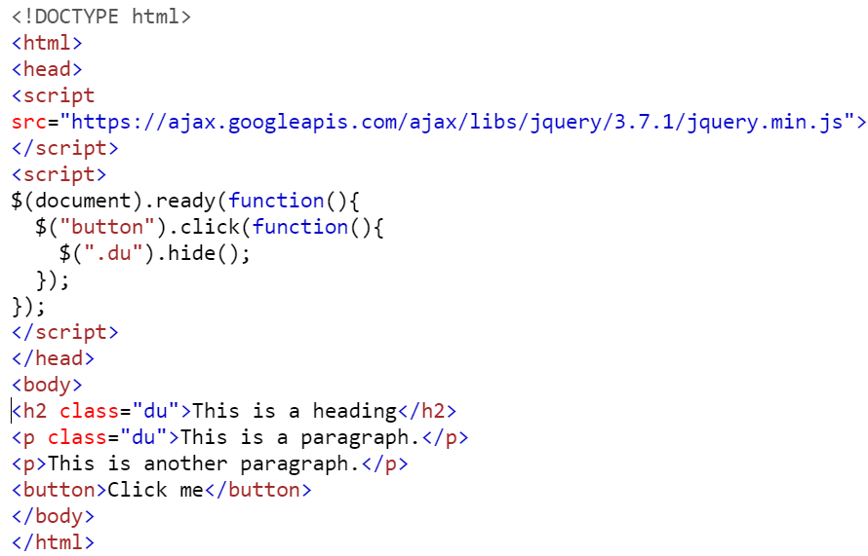
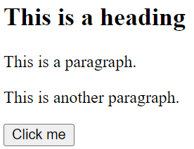

jQuery Example – 3 (Hide all elements with class=“test”)
Hide All Elements with class = “DU”

Slide 25
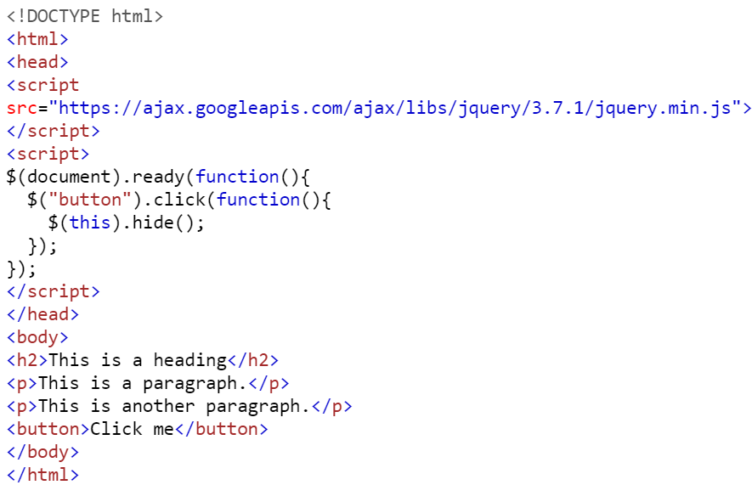
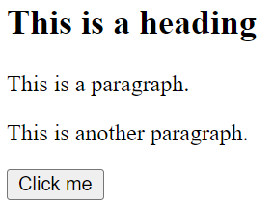
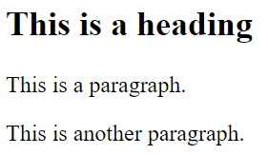
jQuery Example – 4 (Hide the current HTML element)

Slide 26
jQuery v/s Ajax
Parameter | jQuery | Ajax
Complexity | jQuery is a lightweight language that focuses mainly on interacting with HTML components. | Ajax is a robust technology that cannot use HTML since HTML is a simplistic language.
Page Reload | jQuery reloads the page once it has been loaded. | Once the page is loaded, Ajax does not refresh it.
Functionalities | Combining jQuery with other technologies does not result in additional functionality. | Ajax is a mix of numerous different technologies, including CSS, JS, HTML, and DOM, which gives various additional capabilities.
Access | jQuery is accessible via the front-end. | Ajax should be handled appropriately and procedurally to get data from the server.
Server Overloading | Working using jQuery eliminates the possibility of server overload. | Extensive use of Ajax often causes server overload owing to an increase in the number of concurrent connections when Ajax calls are made.

Slide 27
jQuery vs. Raw JavaScript
Cross-Browser Support
jQuery provides cross-browser support.
That is, the same jQuery code runs on the big-5 browsers (Chrome, Firefox, IE, Safari and Opera).
On the other hand, to provide cross-browser support in raw JavaScript, you need to check the browser and issue the appropriate codes, as different browsers (particularly IE) implement certain features differently.
This is done implicitly in jQuery.
DOM Elements Selection and Manipulation
The "query" refers to querying and selecting DOM elements within a web document for subsequent manipulation.
jQuery provides a powerful and supercharged selector function to select elements based on HTML tag-names (e.g., <p>, <button>), HTML ID attribute (e.g., #debug), and CSS class name (e.g., .error).
On the other hand, selecting and manipulating DOM elements using raw JavaScript is messy and hard.
Event Handling:
jQuery also simplifies JavaScript event handling.

Slide 28
jQuery vs. Raw JavaScript
Special Effects and Animation:
jQuery simplifies the programming for special visual effects (such as show/hide, fade-in/fade-out, slide-in/Slide-out) and custom animation.
AJAX Interface:
jQuery provides a simple Ajax interface to send asynchronous HTTP GET/POST requests and process the response.
With jQuery, you can write a few lines of codes to replace tenths of JavaScript codes; and run on all browsers without the need to test on each of them.
The cross-browser support is particularly important for production, as you can't possibly test your JavaScript codes on all browsers.
jQuery is well-tried.
It is reported that jQuery is used by over 65% of the production websites in the Internet!

